Slide 1

Academic Session 2026-27
ODD Semester July-Dec 2026
UNIVERSITY INSTITUTE OF ENGINEERING AND TECHNOLOGY
Department of TT
Bachelor of Engineering (B.E.) – CSE
Advanced Data Structures / Semester 3
(CS220)
Self Study — Unit 1
Topic : Algorithm Analysis and Tree Data Structures
Abhishek Thakur (E19789) Technical Trainer
Sourav Jaiswal (E19756)-MSC Technical Trainer

Slide 2
Self Study Topics — Unit 1 Overview
Amortized Analysis: Aggregate, Accounting, and Potential Methods — analysing average cost over a sequence of operations.
Advanced Recurrences: Master Theorem (3 cases), Substitution Method, Akra-Bazzi Method, Recursion Tree.
Threaded Binary Trees: Replacing NULL pointers with threads for stack-free inorder traversal.
Red-Black Trees: Self-balancing BST with 5 properties, rotations, and O(log n) guaranteed operations.

Slide 3
Self Study Topics — Unit 1 Overview
B-Trees and B+ Trees: Multi-way balanced trees; B+ leaf-linking for efficient range queries (used in databases).
Splay Trees: Self-adjusting BST; recently accessed nodes splayed to root for temporal locality.
Expression Trees: Binary trees representing expressions; traversals yield prefix, infix, postfix notations.
Huffman Trees: Optimal prefix-free encoding built greedily using min-heap; used in data compression.
Space-Time Trade-offs: Memoisation, hash tables, in-place sorting — choosing the right balance for context.

Slide 4
Amortized Analysis — Concept and Motivation
Definition: Amortized analysis gives the average cost per operation over a worst-case sequence of n operations — not a probabilistic average.
Why needed: Some operations are occasionally expensive (e.g. dynamic array doubling) but rarely so. Worst-case per-op analysis is too pessimistic.
Aggregate method: Compute total cost T(n) of n operations; amortized cost = T(n)/n.
Accounting method: Assign amortized charges; excess charge = credit stored for future expensive operations.

Slide 5
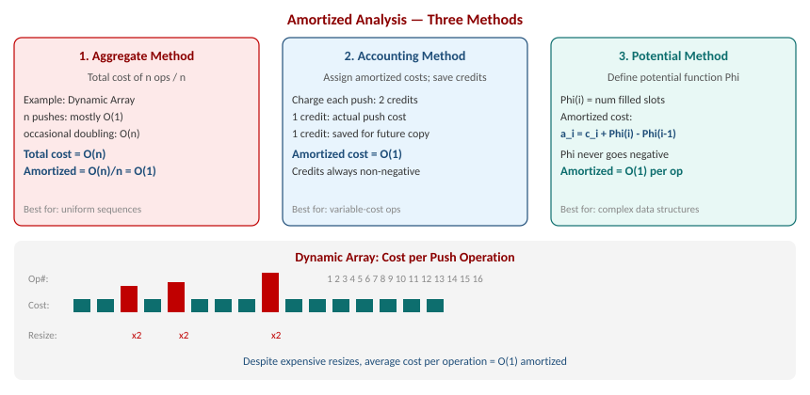
Amortized Analysis — Three Methods with Dynamic Array Example

Slide 6
Advanced Recurrence Relations
Master Theorem: Solves T(n) = aT(n/b) + f(n). Three cases based on comparison of f(n) with n^(log_b a).
Case 1: If f(n) = O(n^c) where c < log_b(a), then T(n) = Theta(n^(log_b a)). Recursion dominates.
Case 2: If f(n) = Theta(n^c * log^k n) where c = log_b(a), then T(n) = Theta(n^c * log^(k+1) n).
Case 3: If f(n) = Omega(n^c) where c > log_b(a) (and regularity holds), then T(n) = Theta(f(n)).
Beyond MT: Substitution (guess + induction) and Akra-Bazzi for non-uniform sub-problem sizes.

Slide 7
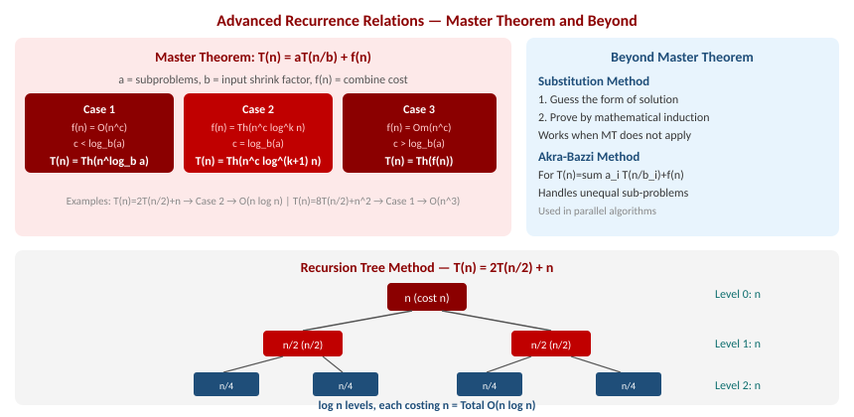
Master Theorem, Cases and Recursion Tree Method

Slide 8
Threaded Binary Trees
Problem: In a binary tree with n nodes, n+1 out of 2n pointer fields are NULL — wasted memory.
Threading: Replace NULL right pointer with pointer to inorder successor; NULL left pointer with inorder predecessor.
Right-threaded: Only right NULLs are replaced. Enables efficient inorder traversal without a stack.
Full threading: Both left and right NULLs replaced. A header node is used as sentinel.

Slide 9
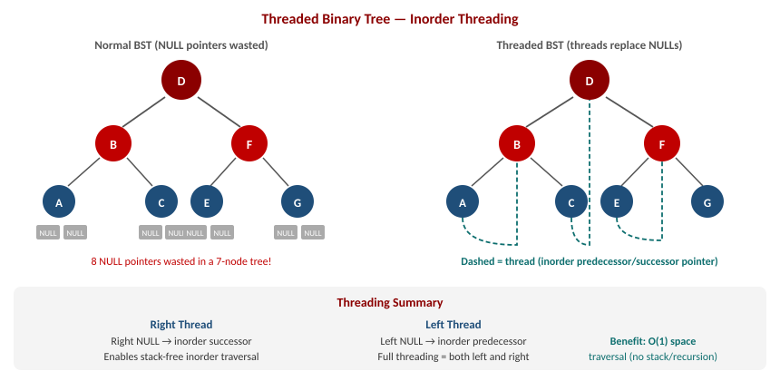
Threaded Binary Tree — Normal BST vs Threaded BST

Slide 10
Red-Black Trees — Self-Balancing BST
Definition: A BST where each node is coloured RED or BLACK, satisfying 5 properties that keep the tree balanced.
Height guarantee: Height is at most 2*log2(n+1), ensuring O(log n) for search, insert, delete.
Insert fix-up: New node inserted as RED. Fix violations using recolouring and rotations (at most 2).
Delete fix-up: Removing a BLACK node may violate black-height. Fixed by at most 3 rotations.

Slide 11
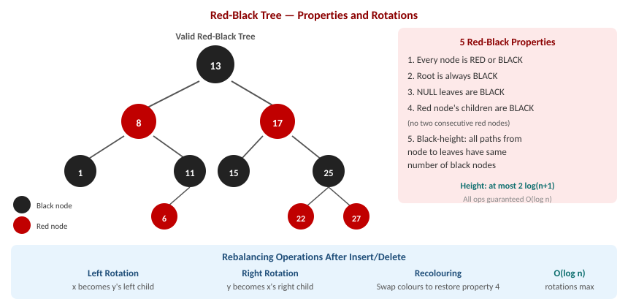
Red-Black Tree — Properties and Rebalancing Operations

Slide 12
B-Trees and B+ Trees — Multi-way Balanced Trees
B-Tree of order m: Every node has at most m children. All leaves at the same depth. Min ceil(m/2) children per non-root node.
B-Tree search: O(log_m n) I/O operations. Wide branching factor minimises disk accesses.
B+ Tree difference: Internal nodes store only keys (routing); ALL data records stored only in leaf nodes.
Leaf linking: Leaf nodes of B+ tree are connected as a doubly linked list — enables fast range queries.

Slide 13
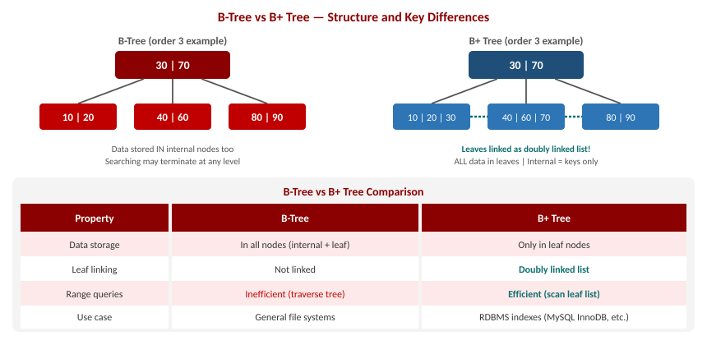
B-Tree vs B+ Tree — Structure, Properties and Comparison

Slide 14
Splay Trees — Self-Adjusting BST
Splay operation: After accessing a node x, rotate x to the root using a sequence of zig, zig-zig, or zig-zag steps.
Temporal locality: Recently accessed nodes stay near the root — fast re-access. Exploits real-world access patterns.
Zig: x is child of root; single rotation brings x to root.
Zig-zig: x and parent are both left (or both right) children; rotate parent first, then x.
Zig-zag: x and parent are opposite children; rotate x twice (same as AVL double rotation).

Slide 15
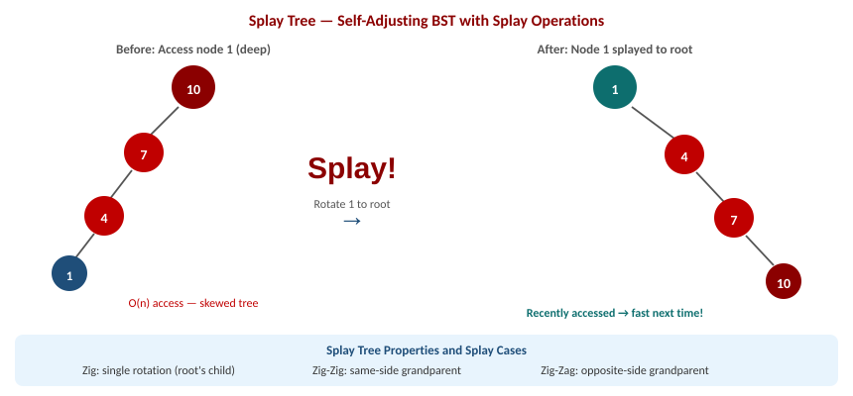
Splay Tree — Splaying a Deep Node to Root

Slide 16
Expression Trees and Tree Applications
Expression tree: A binary tree where leaves are operands (numbers/variables) and internal nodes are operators.
Building: Parse postfix expression using a stack. Push operands; for each operator pop two, create subtree, push back.
Evaluation: Postorder traversal evaluates the expression (left subtree, right subtree, apply operator at root).
Traversal results: Inorder = infix (with parentheses); Preorder = prefix; Postorder = postfix (RPN).

Slide 17
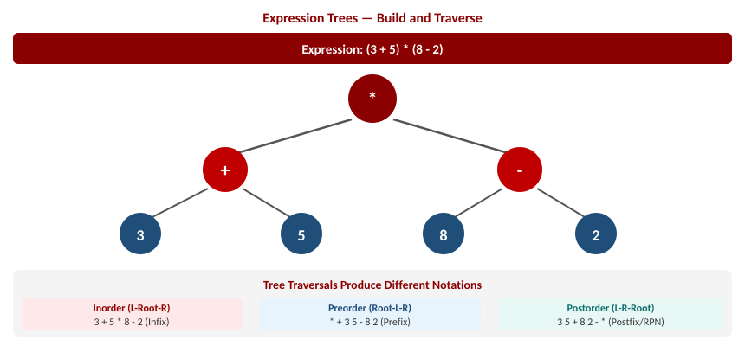
Expression Tree — Build, Traverse and Evaluate (3+5)*(8-2)

Slide 18
Huffman Trees — Optimal Data Compression
Goal: Assign shorter codes to more frequent characters and longer codes to rarer characters (variable-length encoding).
Prefix-free: No code is a prefix of another code — enables unambiguous decoding without separators.
Algorithm: Use a min-priority queue. Repeatedly merge two lowest-frequency nodes into a new internal node.
Greedy proof: Huffman coding is provably optimal — no prefix-free code produces a shorter total encoding.

Slide 19
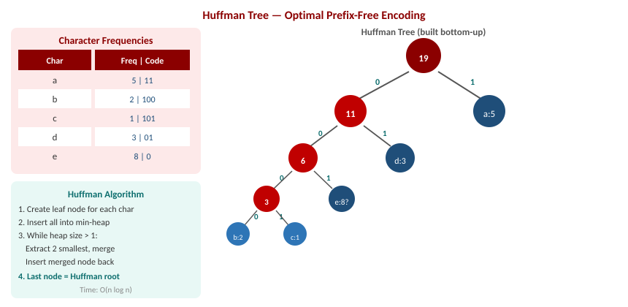
Huffman Tree — Frequency Table, Tree Build and Code Assignment

Slide 20
Space-Time Trade-offs in Algorithms
Core idea: Algorithms can often be made faster by using more memory, or more memory-efficient by doing more computation.
More space, less time: Memoisation (DP), hash tables, precomputed lookup tables, indexed data structures.
Less space, more time: In-place sorting (Bubble, Heap Sort), streaming algorithms, compression with decompression on access.
KMP example: O(m) failure function table built once, enables O(n+m) pattern matching vs O(nm) naive.

Slide 21
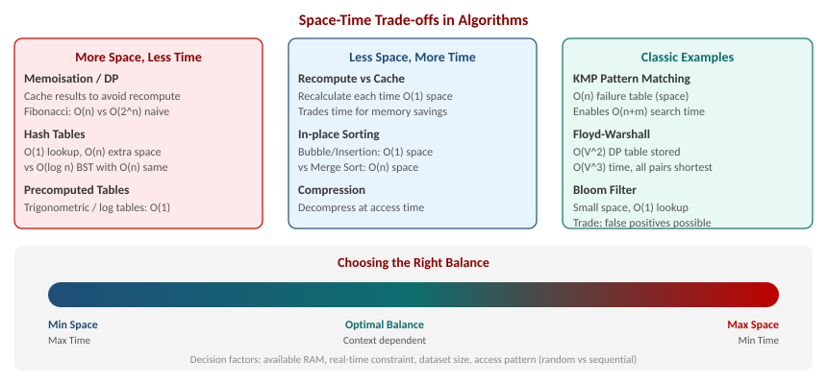
Space-Time Trade-offs — Taxonomy, Examples and Decision Framework

Slide 22
Summary of Self Study Topics
Amortized Analysis: aggregate, accounting, and potential methods give O(1) amortized cost for dynamic array pushes.
Master Theorem solves T(n)=aT(n/b)+f(n) in 3 cases; substitution and Akra-Bazzi handle other forms.
Threaded Binary Trees replace NULL pointers with inorder successor/predecessor links for O(1)-space traversal.
Red-Black Trees guarantee O(log n) via 5 colouring properties and at most 3 rotations per operation.

Slide 23
Summary of Self Study Topics
Splay Trees achieve O(log n) amortized by splaying accessed nodes to root; exploits temporal locality.
Expression Trees encode arithmetic expressions; traversals produce prefix, infix, and postfix notations.
Huffman Trees build optimal prefix-free codes greedily; used in ZIP, JPEG, MP3 compression.
Space-Time Trade-offs: choose memoisation, hash tables, or in-place algorithms based on resource constraints.

Slide 24
Self Study Questions
Q1. Prove that the amortized cost of a push on a dynamic array (with doubling) is O(1) using the accounting method.
Q2. Apply the Master Theorem to: (a) T(n)=4T(n/2)+n (b) T(n)=2T(n/2)+n log n (c) T(n)=3T(n/3)+n^2.
Q3. Explain the 5 properties of a Red-Black Tree. Show a valid RB Tree with 7 nodes.
Q4. Differentiate B-Tree and B+ Tree with respect to data storage, leaf linking, and range query efficiency.
Q5. Build a Huffman Tree for: a=5, b=2, c=1, d=3, e=8. Write the binary codes for each character.
Q6. Describe the zig, zig-zig, and zig-zag splay cases. What is the amortized complexity of a splay operation?
Q7. Given the postfix expression: 3 4 + 2 * 7 -, draw the expression tree and evaluate it.
Q8. Compare in-place sorting (Bubble Sort) vs Merge Sort in terms of the space-time trade-off.

Slide 25
References/ Articles/ Videoseferences/ Articles/ Videos
Cormen, Leiserson, Rivest, Stein — Introduction to Algorithms (CLRS), 3rd Ed., MIT Press.
Knuth — The Art of Computer Programming, Vol. 3 (Sorting and Searching).
GeeksforGeeks — Self Study: https://www.geeksforgeeks.org/advanced-data-structures/
MIT OpenCourseWare 6.006 — Introduction to Algorithms: https://ocw.mit.edu/6-006
Visualgo — Tree Visualisations: https://visualgo.net/en

Slide 26
Thank You
For queries
Email: abhishek.e19789@cumail.in

